Slide 1
Architecting an AI-Powered Sales Dashboard with .NET MAUI and Azure OpenAI
Shriram Sankaran

Slide 2

What are our top‑performing products?
Smart TV — $44,933,415 profit from 1,557,994 total sales
Laptop Pro X — $38,221,104 profit from 1,234,567 total sales
Cloud Server Z — $29,110,876 profit from 987,654 total sales

Slide 3
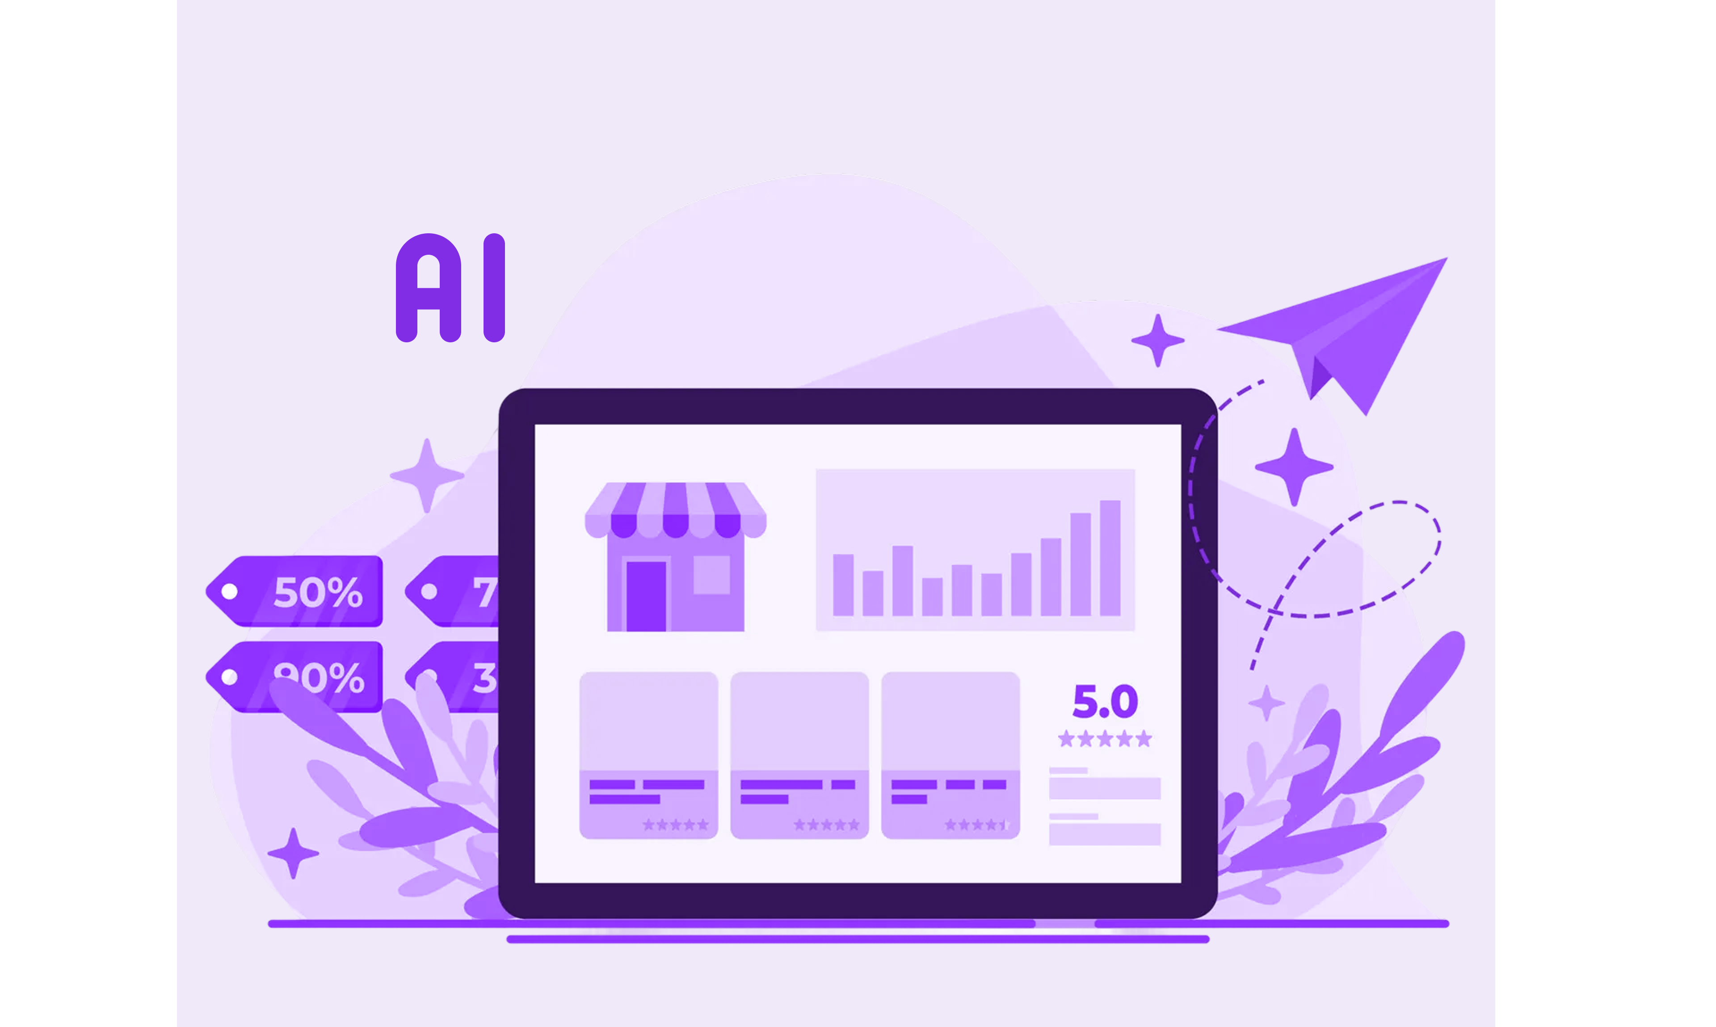

Slide 4
Agenda
01
Overview of the Live Demo
02
Decisions That Mattered
03
Prerequisites
04
Live Demo
05
Architecture Deep-Dive
06
Challenges Solved & Practices Kept
07
Closing

Slide 5
01
Overview of the Live Demo

Slide 6
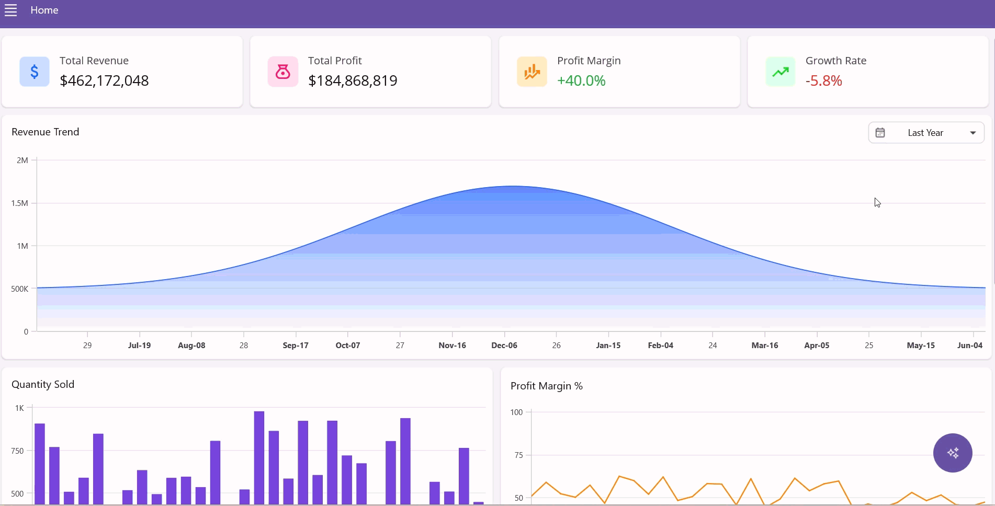
Overview of the Live Demo

Slide 7
02
Decisions That Mattered

Slide 8
Why .NET MAUI?
One codebase, all platforms
Native performance and polished UI
Syncfusion’s .NET MAUI controls
First-class tooling and integration

Slide 9
03
Prerequisites

Slide 10
Prerequisites
Visual Studio 2022 with the .NET MAUI workload
A Syncfusion license
Required NuGet packages
Azure OpenAI account

Slide 11
04
Live Demo

Slide 12
05
Architecture Deep-Dive

Slide 13
06
Challenges Solved & Practices Kept

Slide 14
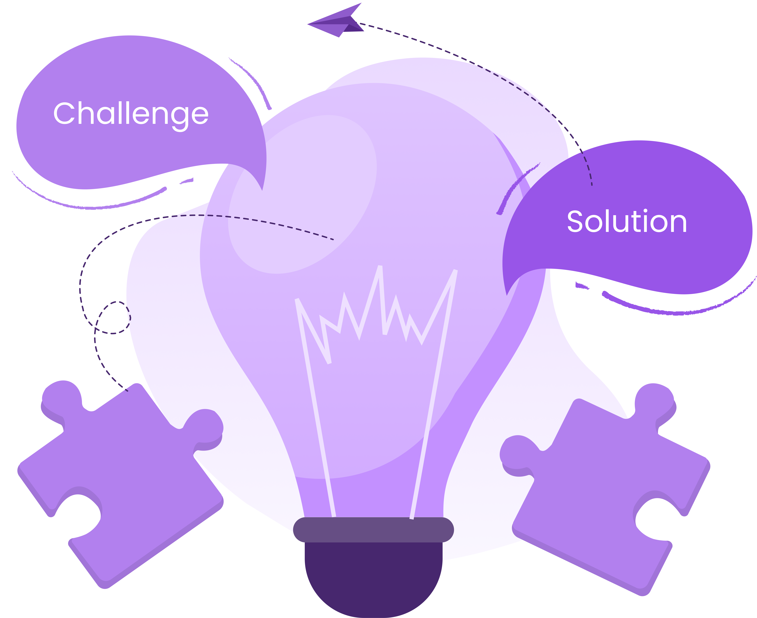
One codebase, two UX compositions
Make refreshes feel instant
Legible charts by default

Slide 15
07
Closing

Slide 16

GitHub Example

Slide 17
Thank you

